Slide 1

ALGEBRA
Math 10-3

Slide 2
LESSON 8
INEQUALITIES

Slide 3
INTERVAL NOTATION

Slide 4


INTERVAL NOTATION
The graph of {x | x > 2 } is shown in Figure P.2. The set is the
real numbers greater than 2.
The parenthesis at 2 indicates that 2 is not included in the set.
Rather than write this set of real numbers using set-builder notation, we can write the set in interval notation as (2, + ).
Figure P.2

Slide 5
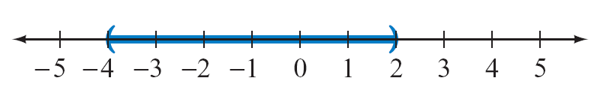
INTERVAL NOTATION
In general, the interval notation
(a, b) represents all real numbers between a and b, not including a and b. This is an open interval. In set-builder notation, we write {x | a < x < b}.
The graph of (–4, 2) is shown in Figure P.3.
Figure P.3

Slide 6

INTERVAL NOTATION
[a, b] represents all real numbers between a and b, including a and b. This is a closed interval. In set-builder notation, we write {x | a ≤ x ≤ b}.
The graph of [0, 4] is shown in Figure P.4. The brackets at 0 and 4 indicate that those numbers are included in the graph.
Figure P.4

Slide 7

INTERVAL NOTATION
(a, b ] represents all real numbers between a and b, not including a but including b. This is a half-open interval. In set-builder notation, we write {x | a < x ≤ b}. The graph of (–1, 3] is shown in Figure P.5.
Figure P.5

Slide 8
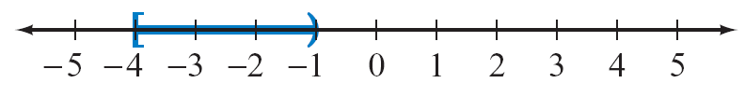
INTERVAL NOTATION
[a, b) represents all real numbers between a and b, including a but not including b. This is a half-open interval. In set-builder notation, we write {x | a ≤ x < b}. The graph of [–4, –1) is shown in Figure P.6.
Figure P.6

Slide 9
INTERVAL NOTATION
Subsets of the real numbers whose graphs extend forever in one or both directions can be represented by interval notation using the infinity symbol or the negative infinity symbol .

Slide 10
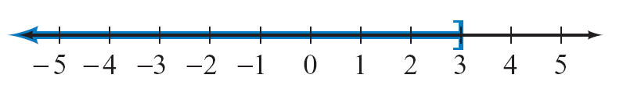
GRAPH A SET GIVEN IN INTERVAL NOTATION
Graph ( , 3] . Write the interval in set-builder notation.
Solution:
The set is the real numbers less than or equal to 3. In set-builder notation, this is the set {x | x ≤ 3}.
Draw a right bracket at 3, and darken the number line to the left of 3, as shown in Figure P.7.
Figure P.7

Slide 11
SOLUTION
cont’d
The set {x |x ≤ –2} ∪ {x | x > 3} is the set of real numbers
that are either less than or equal to –2 or greater than 3.
We also could write this in interval notation as ( , –2] ∪ ( 3, + ).
The graph of the set is shown in Figure P.8.
Figure P.8

Slide 12

SOLUTION
cont’d
The set {x | x > – 4} ∩ {x | x < 1} is the set of real numbers that
are greater than – 4 and less than 1.
Note from Figure P.9 that this set is the interval (– 4, 1), which can be written in set-builder notation as {x | – 4 < x < 1}.
Figure P.9

Slide 13
PROPERTIES OF INEQUALITIES

Slide 14
PROPERTIES OF INEQUALITIES
We have used inequalities to describe the order of real numbers and to represent subsets of real numbers. In this section we consider inequalities that involve a variable.
In particular, we consider how to determine which real numbers make an inequality a true statement.
The solution set of an inequality is the set of all real numbers for which the inequality is a true statement.
For instance, the solution set of x + 1 > 4 is the set of all real numbers greater than 3.

Slide 15
PROPERTIES OF INEQUALITIES
Two inequalities are equivalent inequalities if they have the same solution set.
We can solve many inequalities by producing simpler but equivalent inequalities until the solutions are readily apparent.
To produce these simpler but equivalent inequalities, we often apply the following properties.

Slide 16
PROPERTIES OF INEQUALITIES
Properties of Inequalities
Let a, b, and c be real numbers.
1. Addition–Subtraction Property If the same real number is added to or subtracted from each side of an inequality, the resulting inequality is equivalent to the original inequality.
a < b and a + c < b + c are equivalent inequalities.

Slide 17
PROPERTIES OF INEQUALITIES
2. Multiplication–Division Property
a. Multiplying or dividing each side of an inequality by the same positive real number produces an equivalent inequality.
If c > 0, then a < b and ac < bc are equivalent inequalities.
b. Multiplying or dividing each side of an inequality by the same negative real number produces an equivalent inequality provided the direction of the inequality symbol is reversed.
If c < 0, then a < b and ac > bc are equivalent inequalities.

Slide 18
PROPERTIES OF INEQUALITIES
EXAMPLE
Property 1: Adding or subtracting the same number to (from) each side of an inequality produces an equivalent inequality.
x – 4 < 7 x + 3 > 5
x – 4 + 4 < 7 + 4 x + 3 – 3 > 5 – 3
x < 11 x > 2

Slide 19
PROPERTIES OF INEQUALITIES
Property 2a: Multiplying or dividing each side of an inequality by the same positive number produces an equivalent inequality.

Slide 20
PROPERTIES OF INEQUALITIES
Property 2b: Multiplying or dividing each side of an inequality by the same negative number produces an equivalent inequality provided the direction of the inequality symbol is reversed.

Slide 21
PROPERTIES OF INEQUALITIES
Note the difference between Property 2a and Property 2b.
Property 2a states that an equivalent inequality is produced
when each side of a given inequality is multiplied (divided)
by the same positive real number and the inequality symbol
is not changed.
By contrast, Property 2b states that when each side of a given inequality is multiplied (divided) by a negative real number, we must reverse the direction of the inequality symbol to produce an equivalent inequality.

Slide 22
PROPERTIES OF INEQUALITIES
For instance, multiplying both sides of –b < 4 by –1
produces the equivalent inequality b > –4. (We multiplied
both sides of the first inequality by –1, and we changed the
“less than” symbol to a “greater than” symbol.)

Slide 23
SOLVE LINEAR INEQUALITIES
Solve each of the following inequalities.
a. 2x + 1 < 7 b. –3x – 2 ≤ 10
Solution:
a. 2x + 1 < 7
2x < 6
x < 3
The inequality 2x + 1 < 7 is true for all real numbers less than 3. In set-builder notation, the solution set is given by {x | x < 3}.
Add –1 to each side and keep the inequality symbol as is.
Divide each side by 2 and keep the inequality symbol as is.

Slide 24
SOLUTION
cont’d
In interval notation, the solution set is ( 3).
See the following figure.
b. –3x – 2 ≤ 10
–3x ≤ 12
x ≥ –4
The inequality –3x – 2 ≤ 10 is true for all real numbers greater than or equal to –4.
Add 2 to each side and keep the inequality symbol as is.
Divide each side by –3 and reverse the direction of the
inequality symbol.

Slide 25
SOLUTION
cont’d
In set-builder notation, the solution set is given by {x | x ≥ –4}.
In interval notation, the solution set is [–4, ).
See the following figure.

Slide 26
COMPOUND INEQUALITIES

Slide 27
COMPOUND INEQUALITIES
A compound inequality is formed by joining two inequalities with the connective word and or or. The inequalities shown below are compound inequalities.
x + 1 > 3 and 2x – 11 < 7
x + 3 > 5 or x – 1 < 9
The solution set of a compound inequality with the connective word or is the union of the solution sets of the two inequalities. The solution set of a compound inequality with the connective word and is the intersection of the solution sets of the two inequalities.

Slide 28
SOLVE COMPOUND INEQUALITIES
Solve each compound inequality. Write each solution in set-builder notation.
a. 2x < 10 or x + 1 > 9 b. x + 3 > 4 and 2x + 1 > 15
Solution:
a. 2x < 10 or x + 1 > 9
x < 5 x > 8
{x | x < 5} {x | x > 8}
{x | x < 5} ∪ {x | x > 8} = {x | x < 5 or x > 8}
Solve each inequality.
Write each solution as a set.
Write the union of the
solution sets.

Slide 29
SOLUTION
cont’d
b. x + 3 > 4 and 2x + 1 > 15
x > 1 2x > 14
x > 7
{x | x > 1} {x | x > 7}
{x | x > 1} ∩ {x | x > 7} = {x | x > 7}
Solve each inequality.
Write each solution as a set.
Write the intersection of the solution sets.

Slide 30
COMPOUND INEQUALITIES
The inequality given by
12 < x + 5 < 19
is equivalent to the compound inequality 12 < x + 5 and
x + 5 < 19 .You can solve 12 < x + 5 < 19 by either of the following methods.
Method 1
Find the intersection of the solution sets of the inequalities
12 < x + 5 and x + 5 < 19.
12 < x + 5 and x + 5 < 19
7 < x x < 14

Slide 31
COMPOUND INEQUALITIES
The solution set is
{x | x > 7} ∩ {x | x < 14} = {x | 7 < x < 14}.
Method 2
Subtract 5 from each of the three parts of the inequality.
12 < x + 5 < 19
12 – 5 < x + 5 – 5 < 19 – 5
7 < x < 14
The solution set is {x | 7 < x < 14}.

Slide 32
ABSOLUTE VALUE INEQUALITIES

Slide 33
ABSOLUTE VALUE INEQUALITIES
The solution set of the absolute value inequality | x – 1 | < 3 is the set of all real numbers whose distance from 1 is less than 3.
Therefore, the solution set consists of all numbers between –2 and 4.
See Figure 1.6. In interval notation, the solution set is (–2, 4)
|x – 1| < 3
Figure 1.6

Slide 34
ABSOLUTE VALUE INEQUALITIES
The solution set of the absolute value inequality | x – 1 | > 3 is the set of all real numbers whose distance from 1 is greater than 3.
Therefore, the solution set consists of all real numbers less than –2 or greater than 4.
See Figure 1.7. In interval notation, the solution set is ( , –2) ∪ (4, )
| x – 1| > 3
Figure 1.7

Slide 35
ABSOLUTE VALUE INEQUALITIES
The following properties are used to solve absolute value inequalities.
Properties of Absolute Value Inequalities
For any variable expression E and any nonnegative real number k,
| E | ≤ k if and only if –k ≤ E ≤ k
| E | ≥ k if and only if E ≤ –k or E ≥ k

Slide 36
ABSOLUTE VALUE INEQUALITIES
These properties also hold true when the < symbol is substituted for the ≤ symbol and when the > symbol is substituted for the ≥ symbol.
EXAMPLE
If | x | < 5, then –5 < x < 5.
If | x | > 7, then x < –7 or x > 7.

Slide 37
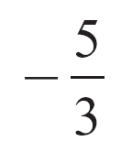
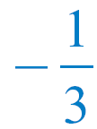
SOLVE ABSOLUTE VALUE INEQUALITIES
Solve each of the following inequalities.
a. | 2 – 3x | < 7 b. | 4x – 3 | ≥ 5
Solution:
a. | 2 – 3x | < 7 if and only if –7 < 2 – 3x < 7. Solve this compound inequality.
–7 < 2 – 3x < 7
–9 < –3x < 5
3 > x >
Subtract 2 from each of the three parts of the inequality.
Multiply each part of the inequality by and reverse the inequality symbols.

Slide 38
SOLUTION
cont’d
In interval notation, the solution set is given by
See Figure 1.8.
Figure 1.8

Slide 39
SOLUTION
cont’d
b. | 4x – 3 | ≥ 5 implies 4x – 3 ≤ –5 or 4x – 3 ≥ 5. Solving each of these inequalities produces
4x – 3 ≤ –5 or 4x – 3 ≥ 5
4x ≤ –2 4x ≥ 8
x ≥ 2
The solution set is
See Figure 1.9.
Figure 1.9

Slide 40
POLYNOMIAL INEQUALITIES

Slide 41
POLYNOMIAL INEQUALITIES
Any value of x that causes a polynomial in x to equal zero is called a zero of the polynomial.
For example, –4 and 1 are both zeros of the polynomial x² + 3x – 4 because (–4)² + 3(–4) – 4 = 0 and 1² + 3  1 – 4 = 0.
Sign Property of Polynomials
Polynomials in x have the following property: for all values of x between two consecutive real zeros, all values of the polynomial are positive or all values of the polynomial are negative.

Slide 42
POLYNOMIAL INEQUALITIES
In our work with inequalities that involve polynomials, the real zeros of the polynomial are also referred to as critical values of the inequality.
On a number line, the critical values of an inequality separate the real numbers that make the inequality true from those that make it false.
For instance, to solve the inequality x² + 3x – 4 < 0, we begin by solving the equation x² + 3x – 4 = 0 to find the real zeros of the polynomial.

Slide 43
POLYNOMIAL INEQUALITIES
x² + 3x – 4 = 0
(x + 4)(x – 1) = 0
x + 4 = 0 or x – 1 = 0
x = –4 x = 1
The real zeros are –4 and 1. They are the critical values of the inequality x² + 3x – 4 < 0, and they separate the real number line into three intervals, as shown in Figure 1.10.
Figure 1.10

Slide 44
POLYNOMIAL INEQUALITIES
To determine the intervals in which x² + 3x – 4 is less than 0, pick a number called a test value from each of the three intervals and then determine whether x² + 3x – 4 is less than 0 for each of these test values.
For example, in the interval ( , –4), pick a test value of –5. Then
x² + 3x – 4 = (–5)² + 3(–5) – 4 = 6
Because 6 is not less than 0, by the sign property of polynomials, no number in the interval ( , –4) makes x² + 3x – 4 less than 0.

Slide 45
POLYNOMIAL INEQUALITIES
Now pick a test value from the interval (–4, 1)—say, 0. When x = 0,
x² + 3x – 4 = 0² + 3(0) – 4 = –4
Because –4 is less than 0, by the sign property of polynomials, all numbers in the interval (–4, 1) make
x² + 3x – 4 less than 0.
If we pick a test value of 2 from the interval ( 1, + ), then
x² + 3x – 4 = (2)² + 3(2) – 4 = 6

Slide 46
POLYNOMIAL INEQUALITIES
Because 6 is not less than 0, by the sign property of polynomials, no number in the interval (1, + ) make x² + 3x – 4 less than 0.
The following table is a summary of our work.

Slide 47
POLYNOMIAL INEQUALITIES
In interval notation, the solution set of x² + 3x – 4 < 0 is (–4, 1).
The solution set is graphed in Figure 1.11.
Note that in this case the critical values –4 and 1 are not included in the solution set because they do not make x² + 3x – 4 less than 0.
Figure 1.11

Slide 48
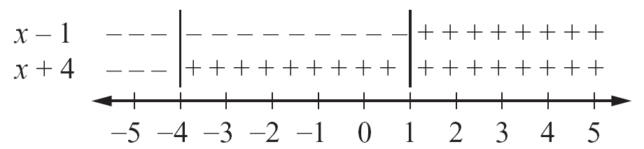
POLYNOMIAL INEQUALITIES
To avoid the extensive arithmetic, we often use a sign diagram.
For example, note that the factor (x + 4) is negative for all x < –4 and positive for all x > –4.
The factor (x – 1) is negative for all x < 1 and positive for all
x > 1.
These results are shown in Figure 1.12.
Sign diagram for x² + 3x – 4 < 0
Figure 1.12

Slide 49
POLYNOMIAL INEQUALITIES
Because we are trying to solve x² + 3x – 4 < 0, we want the interval for which the product of the factors is negative (the polynomial is less than zero).
From the sign diagram, we can visually determine that this interval is where the factors have opposite signs. See Figure 1.13.
The solution is the interval (–4, 1).
Figure 1.13

Slide 50
SOLVE A POLYNOMIAL INEQUALITY
Find the solution set of x³ + 3x² – 4x – 12 ≥ 0. Write the answer in interval notation.
Solution:
Find the zeros of the polynomial.
x³ + 3x² – 4x – 12 = 0
(x + 3)(x + 2)(x – 2) = 0
The zeros are –3, –2, and 2.
Factor by grouping.

Slide 51
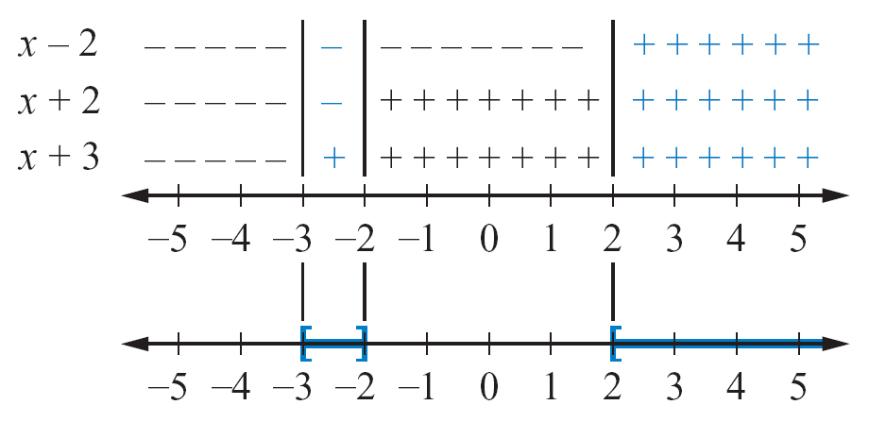

SOLUTION
cont’d
Draw a sign diagram using these values. See Figure 1.14.
Because the inequality is ≥, find the intervals for which the product of the factors is positive or zero.
From the diagram, the solution set is [–3, 2] ∪ [2, ).
The inequality is ≥, so we use brackets, except after the infinity symbol.
Figure 1.14

Slide 52
POLYNOMIAL INEQUALITIES
Following is a summary of the steps used to solve polynomial inequalities by the critical value method.
Solving a Polynomial Inequality by the Critical Value Method
1. Write the inequality so that one side of the inequality is a nonzero polynomial and the other side is 0.
2. Find the real zeros of the polynomial. They are the critical values of the original inequality.
3. Use test values to determine which of the consecutive intervals formed by the critical values are to be included in the solution set.

Slide 53
RATIONAL INEQUALITIES

Slide 54
RATIONAL INEQUALITIES
A rational expression is the quotient of two polynomials. Rational inequalities involve rational expressions, and they can be solved by an extension of the critical value method.
Definition of a Critical Value of a Rational Expression
A critical value of a rational expression is a number that causes the numerator of the rational expression to equal zero or the denominator of the rational expression to equal zero.

Slide 55
RATIONAL INEQUALITIES
Rational expressions also have the property that they remain either positive for all values of the variable between consecutive critical values or negative for all values of the variable between consecutive critical values.
Following is a summary of the steps used to solve rational inequalities by the critical value method.

Slide 56
RATIONAL INEQUALITIES
Solving a Rational Inequality Using the Critical Value Method
1. Write the inequality so that one side of the inequality is a rational expression and the other side is zero.
2. Find the real zeros of the numerator of the rational expression and the real zeros of its denominator. They are the critical values of the inequality.
3. Use test values to determine which of the consecutive intervals formed by the critical values are to be included in the solution set.

Slide 57
SOLVE A RATIONAL INEQUALITY
Solve:
Solution:
Write the inequality so that 0 appears on the right side of the inequality.

Slide 58
SOLUTION
cont’d
Write the left side as a rational expression.
The LCD is x + 1.
Simplify.

Slide 59
SOLUTION
cont’d
The critical values of this inequality are –2 and –1 because the numerator x + 2 is equal to zero when x = –2 and the denominator x + 1 is equal to zero when x = –1.
The critical values –2 and –1 separate the real number line into the three intervals ( , –2), (–2, –1), and (–1, + ).
All values of x on the interval (–2, –1) make negative, as desired.
On the other intervals, the quotient is positive.

Slide 60
SOLUTION
cont’d
See the sign diagram in Figure 1.15.
The solution set is [–2, –1).
Figure 1.15

Slide 61
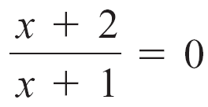
SOLUTION
cont’d
The graph of the solution set is shown in Figure 1.16.
Note that –2 is included in the solution set because
when x = –2.
However, –1 is not included in the solution set because the denominator (x + 1) is zero when x = –1.
Figure 1.16

Slide 62
APPLICATIONS OF INEQUALITIES

Slide 63
Example 6 – Solve an Application Concerning Leases
A real estate company needs a new copy machine. The company has decided to lease either the model ABC machine for $75 a month plus 5 cents per copy or the model XYZ machine for $210 a month and 2 cents per copy. Under what conditions is it less expensive to lease the XYZ machine?
Solution:
Let x represent the number of copies the company produces per month.

Slide 64
Example 6 – Solution
cont’d
The dollar costs per month are 75 + 0.05x for model ABC and 210 + 0.02x for model XYZ.
It will be less expensive to lease model XYZ provided
210 + 0.02x < 75 + 0.05x
210 – 0.03x < 75
–0.03x < – 135
x > 4500
The company will find it less expensive to lease model XYZ if it produces more than 4500 copies per month.
Subtract 0.05x from each side.
Subtract 210 from each side.
Divide each side by –0.03. Reverse the inequality symbol.

Slide 65
APPLICATIONS OF INEQUALITIES
In many business applications, companies are interested in the cost C of manufacturing x items, the revenue R generated by selling all the items, and the profit P made by selling the items.
The following profit formula shows the relationship between profit P, revenue R, and cost C.
P = R – C

